Slide 1
Intercultural Skills for Global Success

Slide 2
Program Agenda
Introductions and Overview
Perceptions and the Nature of Culture
Cultural Values and Communication Styles
Cultural Challenges in Business
Culture Shock and Adaptation
Strategies for Adjustment

Slide 3
Program Objectives
Explore the nature of culture and the challenges of cultural differences
Identify values preferences and compare those to the host culture
Examine the nature of culture shock and stress
Establish successful strategies for adaptation

Slide 4
Chapter 1: Crossing Cultures
Entering a new cultural environment and the questions that arise.

Slide 5
Where are you going from here?
What are your previous experiences of crossing cultures?
What are your immediate concerns?
What are your personal and professional goals and objectives?
What is your attitude toward the assignment?
What do you need to feel prepared for this experience?

Slide 6
New Roles
What new roles will you be assuming?
Intercultural manager
Cultural change agent
Teacher of corporate culture and values
Cultural bridge with home office
Intercultural parent
Facilitator for transfer of technology
Cultural mediator
Intercultural teacher
Cultural learner

Slide 7
Perception of Other Cultures
What are the cultures you are familiar with?
What are your perceptions of those cultures?
What is your perception of your destination culture?

Slide 8
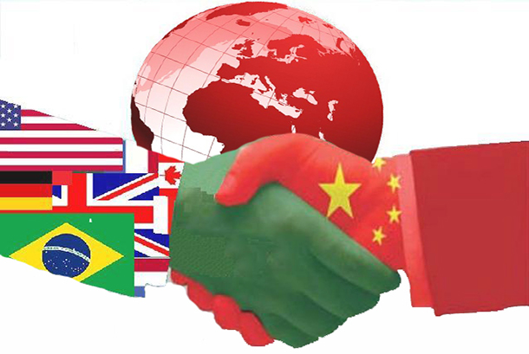
Intercultural Adaptation:
Who should adapt to whom?
When in Rome (China)…
or
…do as the Romans (Chinese do)?
…just be yourself?
It depends!

Slide 9
Chapter 2: Cultural Beliefs and Values
“The differences which distinguish human societies are not biological. They are cultural.”

Slide 10
Perception
“We don’t see things the way they are-we see things the way we are.” -Anaϊs Nin
USA = Pest China = Pet
Thailand = Appetizer

Slide 11
Stereotypes
Rigid, fixed
Oversimplified
Put people in a box
Negative
“Americans are self-centered and don’t care about others.”
“The Chinese never give you a straight answer.”

Slide 12
Generalizations
Fluid, flexible
Allow for individual differences
Backed by research
Tools for understanding
“Americans tend to be individualistic and task-oriented.”
“Most Chinese practice indirect communication to help others save face.”

Slide 13
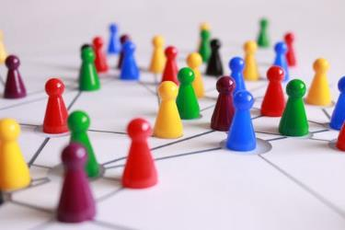
What is Culture?
Learned and shared ways of thinking, feeling, communicating, behaving, working
Differentiates teams, companies and nations from one another
Shapes and develops our viewpoints
Filter through which we see the world and the workplace

Slide 14
Ethnocentrism and Perception
We don’t see things the way they are, we see things the way we are.
Because members of your destination culture have different values, beliefs, attitudes and perspectives, they behave differently than you do.
It is natural to prefer your origin culture’s way of doing things and to react negatively to unfamiliar ways of approaching common tasks (ethnocentrism).
You can choose to manage these unavoidable judgmental reactions as you observe and slowly get uses to these differences.
Over time, you may choose to adapt to some of these or find other ways to meet your needs and goals as you become effective in your new environment.

Slide 15
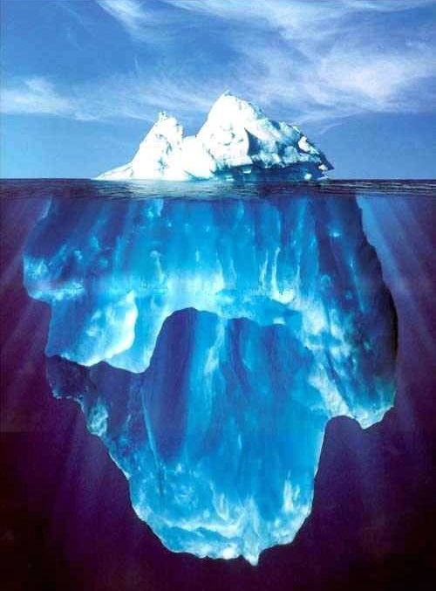
The Iceberg of Culture
More than what meets the eye.

Slide 16
The Iceberg of Culture
Sensory input: what we can observe, see, smell, taste, hear, touch… (Easy to notice)
Values/Beliefs/Attitudes
Patterns of Thinking
Patterns of Communicating
Patterns of Social Organization
(Hard to observe – below the water line)

Slide 17
Layers of Culture
Individual
Gender
Ethnic
Generational
Organizational
City
Regional
National
Global

Slide 18
Continua of Cultural Values & Characteristics
Task Tasks can be accomplished before relationships | Relationship Things get done when the relationships are in place
Explicit Meaning is stated directly. | Implicit Meaning often must be inferred
Individual Me before we | Group We before me
Risk Taking Make change happen; act decisively. New is good. | Risk Avoiding Avoid change. Steady, but sure. Stress continuity.
Tight Be punctual; control time; time is money | Loose Be Flexible, go with the flow.
Shared Power and authority is distributed within the group | Concentrated Power and authority given to specific people
Linear Analytical, step-by-step process toward solutions | Circular Focus on exploring & integrating perspectives in a less unstructured way
Facts Emphasis on data and concrete experiences | Thinking Emphasis on reasoning, concepts and data
Simple Reduce to basics. Essentials with little context. | Complex Detailed, contextual understanding
Relating
Regulating
Reasoning

Slide 19
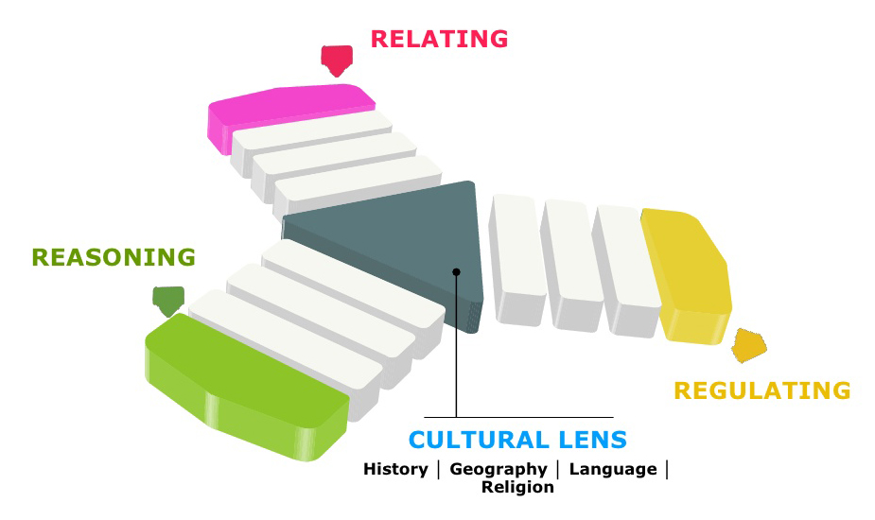
TMA World Prism: The Country Navigator
This is the TMA Worldprism. It can help is to identify certain areas of cultural and interpersonal difference.
Use your cultural profile to better understand your own “world prism”

Slide 20
Learning from Critical Incidents
What is happening? | Why is it happening? |  | What could have been done differently?
What are the various behaviors that are occurring? | Values of Culture 1? | Values of Culture 2? | Strategies?

Slide 21
Are you task or relationship oriented?
Getting the job done: Task Orientation
Tasks and statistics drive the business; goals are achieved; timelines are kept at all costs.
What you know gets the job done.
Getting the job done: Relationship Orientation
Tasks are accomplished through relationships. “Preservation of harmony” is important.
Who you know gets the job done.

Slide 22
How do you see yourself?
Perception of self: Individual
Self perceived as an individual with limited responsibility to the group
Perception of self: Group Member
Self identity based on the membership of a cultural group, family or work group

Slide 23
Status and Hierarchy
Power: Concentrated
Hierarchical societies are more formal. Social status is well defined and a select few have authority. Acceptance of the necessity of layers of authority.
Power: Shared
Flatter societies are more informal, and it is possible to rise and fall in them by one’s own endeavors. Authority is more likely to be shared.

Slide 24
What is your attitude toward uncertainty?
Accept Change: Risk-taking
In cultures that accept and value change, taking certain kinds of risks is encouraged.
Resist Change: Risk-avoiding
In cultures that resist change, the preference is for making selected aspects of life predictable.

Slide 25
Concepts of Time: Exact
Our perception and management of time affects how we interact with others, how we plan, coordinate and execute activities.
“Tight” Time
In some cultures, time is treated as a commodity that is not to be wasted. It is conceptualized as a straight line starting in the past and running into the future. People view time in a sequential manner and tend to do “one thing at a time.” They are mostly short-term oriented.
Quick results are expected
“Time is money”
Desire for immediate gratification
Live by the clock
Considers precedence
Analytic thinking
Single focus

Slide 26
Concepts of Time: Fluid
“Loose” Time
In some cultures, time is perceived to be plentiful and has little structure. In its purest form it is intangible and only exists in relationship to events. You may imagine time as a circle, or as a rhythm. Cultures that view time in a circular manner tend to do several things synchronously, or at the same time. They can be either short-term or long-term oriented.
Lower sense of urgency
Time is plentiful
Relationship oriented
Perseverance
Considers current context
Synthetic thinking
Multi-focus

Slide 27
Chapter 3:
Communication Across Cultures
“I know that you believe you understand what it is you think I said, but I am not sure you realize that what you heard is not what I meant.”

Slide 28
How do you communicate?
Topics of Conversation
Nonverbal Communication
What topics do people discuss?
Do people like in-depth discussions or not?
What do people talk about upon first meeting?
Are any topics taboo?
What kind of significant gesturing goes on?
How is space handled?
What is the nature of eye contact?
How is silence used or not?
What are conversational patterns?
Self-Disclosure
How much personal information and how soon?
To what extent do you share personal information at work?

Slide 29
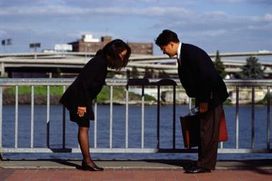
Direct or Indirect
Indirect Communication
Communication is INDIRECT with many non verbal cues.
The CONTEXT is implicit and forms a large part of the meaning.
This style pays attention to the concept of face and to maintaining harmony.
Direct Communication
Communication is DIRECT and to the point.
CONTEXT, if important, is stated explicitly in communication.
Little attention is given to non-verbal cues, face and harmony.
“Tatemae/Honne”
Japanese non-verbal concept of honesty.
Tatemae=surface conversation
Honne=how someone really feels
“Can I be honest with you?”
U.S. concept of “straight talk”

Slide 30
Characteristics of Direct Communication
Exchange of important information does not require prior relationship
Messages delivered are straight to the point
Criticism is open and explicit
Argumentation acceptable, debate valued
Little attention to non-verbal cues

Slide 31
Characteristics of Indirect Communication
Communication focuses on relationship-building and information after
Messages are subtle and can weave around the point
Attention to harmony. No direct criticism or feedback.
Consideration of rank, hierarchy and status
Arguments viewed negatively, confrontational
Body language: expressions, posture, gestures very significant

Slide 32
Emotionally Expressive or Restrained?
Emotions: Expressive
Emotions are an indicator of the importance of the matter.
Trust and emotional commitment are developed, and credibility is established through showing emotions.
Emotions: Restrained
Emotions are discredited as unprofessional.
Trust and credibility are developed through emotional suppression.
Sensitive to hurting feelings of others.

Slide 33
What are the differences between these two?

Slide 34
Encounter of the “Peach” and the “Coconut”
public
private
private
Discomfort Zone

Slide 35
Virtual Communication:
Loss of Bandwidth
 | Words | Control Over Format | Voice Tone | Immediate Feedback | Nonverbal Cues | Environmental Cues | Direct Exchange | Informal Contacts
Person to person
Video Conferencing
Phone
Voice Mail
IM and Chat
Email
Reduced “Bandwidth” = Lost Information
(emails have lost more than 87% of their context)

Slide 36
Chapter 4:
Doing Business in the Host Country
By synergizing our differences, we can take advantage of one another’s strengths.

Slide 37
Managing Differences
MAPPING Understand the differences
BRIDGING
Communicate across the differences
INTEGRATING
Manage the differences
Value the differences and the differences create value.

Slide 38
Onion Model of Culture
Symbols
Heroes
Rituals
Corporate Culture & Practices
Fixed Values by 8-10 years old
Fixed Values by 8-10 years old
Cultures and Organizations: Software of the Mind
by Geert and Jan Hofstede
(2nd edition)

Slide 39
Culturally Influenced Business Functions
Business Consultant: Facilitated Discussion
What is your preferred work style? What goals and challenges have you identified?
Problem Solving
Decision Making
Meetings
Customer Relations
Negotiating/Persuading
Motivating People
Leadership Style
Performance Expectations
Staff Development
Superior/Subordinate Relationships
Presentation Styles
Culture A Culture B Strategies

Slide 40
Chapter 5:
Intercultural Application
Consider culture shock as a natural process, not as a sign of weakness.

Slide 41
Culture Shock:
Rollercoaster of Adjustment
HOME SWEET HOME
HONEYMOON
ADAPTATION
Surprises
Sadness
Lots to Do
Try New Things
Homesickness
Understanding
Fear
Meet New People
I Miss Everyone
Participate
Excitement
Discover
Insecurity
“They’re Wrong!”
Happy
Uncertainty
See New Places
Proud
Stress
Strength
The Unknown
Adventure
Positive
Fatigue
Keep Learning
Good-bye
Pause, Rest
DEPART
CULTURE SHOCK
DEPART
CULTURE SHOCK

Slide 42
Strategies for Adaptation
Immersion
What interests you about your host culture?
What aspect of the host country could you choose to become and “expert” in during your assignment?
Getting Out
When you can’t stand it a moment longer, how can you “escape” from the host culture (literally or virtually?)
What can stay the same?
Household items
Friends you communicate with
Special foods, etc.
Stress Relief
What do you currently do for stress

Slide 43
Repatriation: Part of the Cycle
Why do so many expatriates find repatriating more difficult than expatriating?
What can you do during your assignment to prepare for a smoother transition back to your home country?
In what ways do you anticipate this assignment will change you and your perception of your home culture?

Slide 44
Goal-Setting
SMART Goals
Specific
Measurable
Achievable
Realistic
Time Based
Goal-Setting
Develop at least two SMART goals that will help you interact more effectively in the host culture.
1.
2.

Slide 45
Strategies for Successful Global Moves
Be self-aware. Analyze your cultural preferences and how they affect your social and work style.
Be curious. Learn about the cultural backgrounds of your neighbors and co-workers.
Think about adaptation. Who should adapt to whom, why and how much?
Become interculturally competent. Understand and manage cultural differences proactively.

